Slide 1
Disturbances of Water and Sodium
Brian Locke, MD
2022 Fellow Bootcamp
Notes:
2 other resources to review and add:
https://pubmed.ncbi.nlm.nih.gov/33999276/?dopt=Abstract
https://annalsofintensivecare.springeropen.com/articles/10.1186/s13613-022-01024-6

Slide 2
Roadmap
Disorders of Water
Hyponatremia
Fellow-level schema
When to use DDAVP clamp
Hypernatremia
Why all our ARDS patients are hypernatremia and why Orme’s approach works
Disorders of Sodium
Congestion
Diuresis vs Natriuresis
Inadequate dosing of lasix
When to stop

Slide 3
How does hyponatremia cause problems?
Why does DKA cause “hyponatremia” on labs, but symptoms of “hypernatremia” (thirst/dehydration, AMS)

Slide 4
How does hyponatremia cause problems?
Osmolarity: number of particles in 1L ( that drops the freezing point 1.86 Kelvin; independent of size/weight of particles)
Osmolality: number of particles of 1kg of solvent.
Tonicity: effective osmolality of solutes that can act across a semi-permeable membrane
Osm: property of particle in solution; Tonicity property of solution in relationship to a semipermeable membrane (cell membrane)
Na+: exerts osmotic pressure
Glu: moves across semipermeable membranes w/ insulin – transient (usually)
Urea, ethanol, lactate: passively moves across semipermeable membrane: no osmotic pressure
Notes:
Na causes symptoms by increasing or decreasing the tonicity of the blood. Other causes of hypertonicity will cause similar symptoms.

Slide 5
Hyponatremia: Resident-level algorithm
Are they hyperosmolar?
Lab error? (lipemic, m-prot)
Na+ low enough to care?
Serum Osm
Kidneys appropriate?
Notes:
Math:

Slide 6
Hyponatremia: Resident-level algorithm
Are they hyperosmolar?
Lab error? (lipemic, m-prot)
Na+ low enough to care?
Serum Osm
Kidneys appropriate?
Serum too dilute, urine should be ultra-dilute
No ADH present
Urine Osm
ADH present
Notes:
Math:

Slide 7
Hyponatremia: Resident-level algorithm
Are they hyperosmolar?
Lab error? (lipemic, m-prot)
Na+ low enough to care?
Serum Osm
Kidneys appropriate?
60kg -> 600 mOsm/d solute
50 mOsm: max 12L
1200 mOsm: min 0.5L
No ADH present
Urine Osm
ADH present
U_osm: 50 – 1200 mOsm/kg
< 50 osm per L H2O
Polydipsia (0.75l/hr max UOP)
Beer: EtOH, C₆H₁₂O₆
Tea/Toast (100 mOsm-> 2L max)
Impaired Range (~100 mOsm/kg)
AKI, CKD, Old Age…
Notes:
Math:

Slide 8
Hyponatremia: Resident-level algorithm
Are they hyperosmolar?
Lab error? (lipemic, m-prot)
Na+ low enough to care?
Serum Osm
Kidneys appropriate?
60kg -> 600 mOsm/d solute
50 mOsm: max 12L
1200 mOsm: min 0.5L
No ADH present
Urine Osm
ADH present
Appropriate?
U_osm: 50 – 1200 mOsm/kg
< 50 osm per L H2O
Polydipsia (0.75l/hr max UOP)
Beer: EtOH, C₆H₁₂O₆
Tea/Toast (100 mOsm-> 2L max)
Impaired Range (~100 mOsm/kg)
AKI, CKD, Old Age…
Urine Na
(Why not FENa?*)
ADH like a vasopressor (decreased EABV)
Not Appropriate:
SIADH etc.
Notes:
Math:

Slide 9
Hyponatremia: Resident-level algorithm
Are they hyperosmolar?
Lab error? (lipemic, m-prot)
Na+ low enough to care?
Serum Osm
Kidneys appropriate?
60kg -> 600 mOsm/d solute
50 mOsm: max 12L
1200 mOsm: min 0.5L
No ADH present
Urine Osm
ADH present
Appropriate?
U_osm: 50 – 1200 mOsm/kg
< 50 osm per L H2O
Polydipsia (0.75l/hr max UOP)
Beer: EtOH, C₆H₁₂O₆
Tea/Toast (100 mOsm-> 2L max)
Impaired Range (~100 mOsm/kg)
AKI, CKD, Old Age…
Urine Na
ADH like a vasopressor (decreased EABV)
Not Appropriate:
SIADH etc.
Hypovolemic
Maldistributed
Hypervolemic

Slide 10
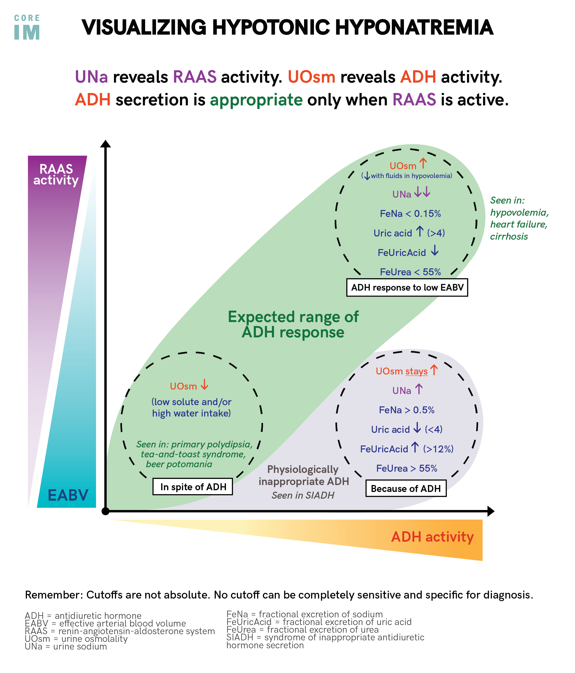
Notes:
https://twitter.com/COREIMpodcast/status/1552252666486693891?s=20&t=FY4wH6UpeCJDE8T_i_sQYA

Slide 11
Hyponatremia: Fellow-level algorithm
Are they hyperosmolar?
Lab error? (lipemic, m-prot)
Na+ low enough to care?
What happened with 1L NS in ED?
Clinical Situation (IVIG?)
Kidneys appropriate?
*Low U_Spec Grav: specific, not sensitive
No ADH present
ADH present
Appropriate?
U_osm: 50 – 1200 mOsm/kg
< 50 osm per L H2O
Polydipsia (H2O up)
Beer: EtOH, C₆H₁₂O₆
Tea/Toast (osm down)
Impaired Range
AKI, CKD, Old Age…
ADH like a vasopressor (decreased EABV)
Not Appropriate:
SIADH etc.
Hypovolemic
Maldistributed
Hypervolemic
Notes:
https://www.amjmedsci.org/action/showPdf?pii=S0002-9629%2815%2934526-2

Slide 12
Hyponatremia: Fellow-level algorithm
Na+ low enough to care?
What happened with 1L NS in ED?
154*2 MEq=mOsm Na Cl allows 6L free water loss if ADH gone
Kidneys appropriate?
60kg -> 600 mOsm/d solute
50 mOsm: max 12L
1200 mOsm: min 0.5L
No ADH present
ADH present
Appropriate?
U_osm: 50 – 1200 mOsm/kg
< 50 osm per L H2O
Polydipsia (H2O up)
Beer: EtOH, C₆H₁₂O₆
Tea/Toast (osm down)
Impaired Range
AKI, CKD, Old Age…
ADH like a vasopressor (decreased EABV)
Not Appropriate:
SIADH etc.
Hypovolemic
Maldistributed
Hypervolemic
Notes:
https://www.amjmedsci.org/action/showPdf?pii=S0002-9629%2815%2934526-2

Slide 13
Hyponatremia: Fellow-level algorithm
Na+ low enough to care?
What happened with 1L NS in ED?
154*2 MEq=mOsm Na+Cl allows 6L free water loss if ADH gone!
What if ADH to cause min U_osm:
150? 300? 600?
Kidneys appropriate?
60kg -> 600 mOsm/d solute
50 mOsm: max 12L
1200 mOsm: min 0.5L
No ADH present
ADH present
Appropriate?
U_osm: 50 – 1200 mOsm/kg
< 50 osm per L H2O
Polydipsia (H2O up)
Beer: EtOH, C₆H₁₂O₆
Tea/Toast (osm down)
Impaired Range
AKI, CKD, Old Age…
ADH like a vasopressor (decreased EABV)
Not Appropriate:
SIADH etc.
Hypovolemic
Maldistributed
Hypervolemic
Notes:
https://www.amjmedsci.org/action/showPdf?pii=S0002-9629%2815%2934526-2

Slide 14
Hyponatremia: Fellow-level algorithm
Na+ low enough to care?
What happened with 1L NS in ED?
154*2 MEq=mOsm Na+Cl allows 6L free water loss if ADH gone!
What if ADH to cause min U_osm:
150? (2L, Na up) 300? (1L, na unchanged) 600? (500 cc, na down)
Kidneys appropriate?
60kg -> 600 mOsm/d solute
50 mOsm: max 12L
1200 mOsm: min 0.5L
No ADH present
ADH present
Appropriate?
U_osm: 50 – 1200 mOsm/kg
< 50 osm per L H2O
Polydipsia (H2O up)
Beer: EtOH, C₆H₁₂O₆
Tea/Toast (osm down)
Impaired Range
AKI, CKD, Old Age…
ADH like a vasopressor (decreased EABV)
Not Appropriate:
SIADH etc.
Hypovolemic
Maldistributed
Hypervolemic
Notes:
https://www.amjmedsci.org/action/showPdf?pii=S0002-9629%2815%2934526-2

Slide 15
Hyponatremia: Fellow-level algorithm
Na+ low enough to care?
What will happen if we restore EABV to kidneys?
Kidneys appropriate?
60kg -> 600 mOsm/d solute
50 mOsm: max 12L
1200 mOsm: min 0.5L
No ADH present
ADH present
Appropriate?
U_osm: 50 – 1200 mOsm/kg
< 50 osm per L H2O
Polydipsia (H2O up)
Beer: EtOH, C₆H₁₂O₆
Tea/Toast (osm down)
Impaired Range
AKI, CKD, Old Age…
ADH like a vasopressor (decreased EABV)
Not Appropriate:
SIADH etc.
Hypovolemic
Maldistributed
Hypervolemic
Notes:
https://www.amjmedsci.org/action/showPdf?pii=S0002-9629%2815%2934526-2

Slide 16
Hyponatremia: Fellow-level algorithm
Na+ low enough to care?
What will happen if we restore EABV to kidneys?
All the way off: 6L of UOP for 1L NS
Part of the way off: 1L-5L off
U_osm, U_na reflect a physiologic state, not a diagnosis – can cycle them
Kidneys appropriate?
60kg -> 600 mOsm/d solute
50 mOsm: max 12L
1200 mOsm: min 0.5L
No ADH present
Δ Urine Osm
ADH present
Appropriate?
U_osm: 50 – 1200 mOsm/kg
< 50 osm per L H2O
Polydipsia (H2O up)
Beer: EtOH, C₆H₁₂O₆
Tea/Toast (osm down)
Impaired Range
AKI, CKD, Old Age…
ADH like a vasopressor (decreased EABV)
Not Appropriate:
SIADH etc.
Δ Urine Na
Hypovolemic
Maldistributed
Hypervolemic
Notes:
https://www.amjmedsci.org/action/showPdf?pii=S0002-9629%2815%2934526-2

Slide 17
Hyponatremia: Fellow-level algorithm
Na+ low enough to care?
Your intern gave 1L IVF and the patient’s UOP is now 400 cc/hr. What category were they in?
Kidneys appropriate?
60kg -> 600 mOsm/d solute
50 mOsm: max 12L
1200 mOsm: min 0.5L
No ADH present
ADH present
Appropriate?
U_osm: 50 – 1200 mOsm/kg
< 50 osm per L H2O
Polydipsia (H2O up)
Beer: EtOH, C₆H₁₂O₆
Tea/Toast (osm down)
Impaired Range
AKI, CKD, Old Age…
ADH like a vasopressor (decreased EABV)
Not Appropriate:
SIADH etc.
Hypovolemic
Maldistributed
Hypervolemic
Notes:
https://www.amjmedsci.org/action/showPdf?pii=S0002-9629%2815%2934526-2

Slide 18
Hyponatremia: Fellow-level algorithm
Na+ low enough to care?
Your intern gave 1L IVF and the patient’s UOP is now 400 cc/hr. What category were they in?
How could we stop this?
Do not wait for next Na
Kidneys appropriate?
60kg -> 600 mOsm/d solute
50 mOsm: max 12L
1200 mOsm: min 0.5L
No ADH present
ADH present
Appropriate?
U_osm: 50 – 1200 mOsm/kg
< 50 osm per L H2O
Polydipsia (H2O up)
Beer: EtOH, C₆H₁₂O₆
Tea/Toast (osm down)
Impaired Range
AKI, CKD, Old Age…
ADH like a vasopressor (decreased EABV)
Not Appropriate:
SIADH etc.
Hypovolemic
Maldistributed
Hypervolemic
Notes:
https://www.amjmedsci.org/action/showPdf?pii=S0002-9629%2815%2934526-2

Slide 19
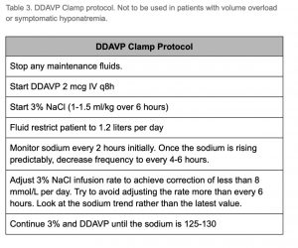
DDAVP clamp:
ALL of the risk of over-correction comes from solute being given when ADH is low (= body can now dump free water at U_osm 50 osm/L)
Adrogue-Madias equation: 1L NS in 70kg w/ Na 105 -> 107.5
2 options:
D5W to match the urine output (that’s a lot of D5; ‘iatrogenic polydipsia’)
Give ADH back (useful whenever UOP high or might become high)
DDAVP 2 mcg IV q8hr, continued until Na at target
Give 3% Saline to increase
Do nothing to keep unchanged
Give D5w to decrease
Notes:
Caveats: KCl needs to be counted; as do medications (don’t put in D5w); restrict oral intake

Slide 20
Hyponatremia: summary
Tools for residents: Serum Osm, Urine Osm, Urine Na (FENa)
Tools for fellows: UOP, response to solutes, clinical circumstance, cycling the labs prn
If the ED gave 1L IVF and the [Na] didn’t budge or worsened:
SIADH etc., or appropriate ADH presence from hypervol/maldistributed
If the ED gave 1L IVF and the patient is making more than 250+ cc/hr
They either had no ADH to start, or reason for ADH is gone (hypovol)
Start DDAVP 2 mcg IV q8h

Slide 21
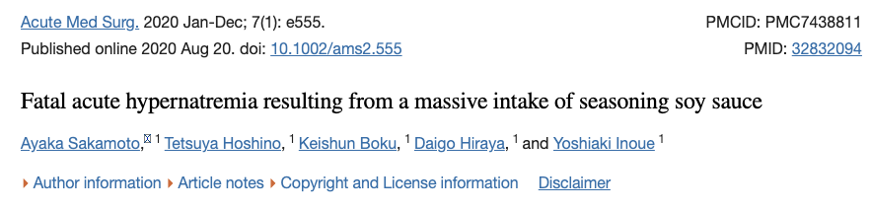
Hypernatremia
60kg -> 600 mOsm/d solute; 50 mOsm: max 12L; 1200 mOsm/L: min 0.5L
With normal solute intake and less than 500cc water, you’d get hypernatremic
If you have Diabetes Insipidus, your maximum concentration drops. If max U_osm = 600 mOsm/L, then <1L leads to hypernatremia. If U_osm = 300, <2 L leads to hypernatremia, etc.
High urine output, CNS tumor, long term lithium and hypernatremic? Check U_osm
1200 mOsm = minimum of 1L of maximally concentrated UOP***

Slide 22
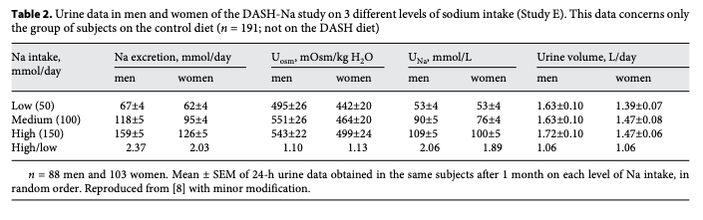
Does someone who eats 2g of Na/d drink the same H2O as someone who eats 4g of Na/d?
Yes – at steady state – in = out.
Over a large range of sodium intake, urine production and thus fluid intake will be constant
More natriuresis occurs in people who eat more salt.
Notes:
Bankir L, Perucca J, Norsk P, Bouby N, Damgaard M. Relationship
between sodium intake and water intake: the false and the true. Ann
Nutr Metab. 2017;70(Suppl 1):51–61.

Slide 23
Physiology Review
Large bolus of free water?
ADH shuts off. Kidneys produce dilute urine. Electrolytes and volume status unchanged.
For avg (10 mOsm/kg/day) diet, ADH fully off = 50 mmol/L (maximally dilute) 70 kg person => 700 mmol load => 50 mmol/L excretion => 14L of free water can be excreted per day without perturbing sodium balance.
Large bolus of sodium?
Maximal natriuresis ~280 mmol/L (2x serum, roughly).
Why? There is NO active sodium excretion along the nephron
Notes:
Compare: potassium, urea can concentrate 10-1000x the plasma – partly because serum concentrations of these things are much lower
Threshold of 250-300 mmol per day before U_na alone is not enough to compensate, and V will increase to compensate

Slide 24
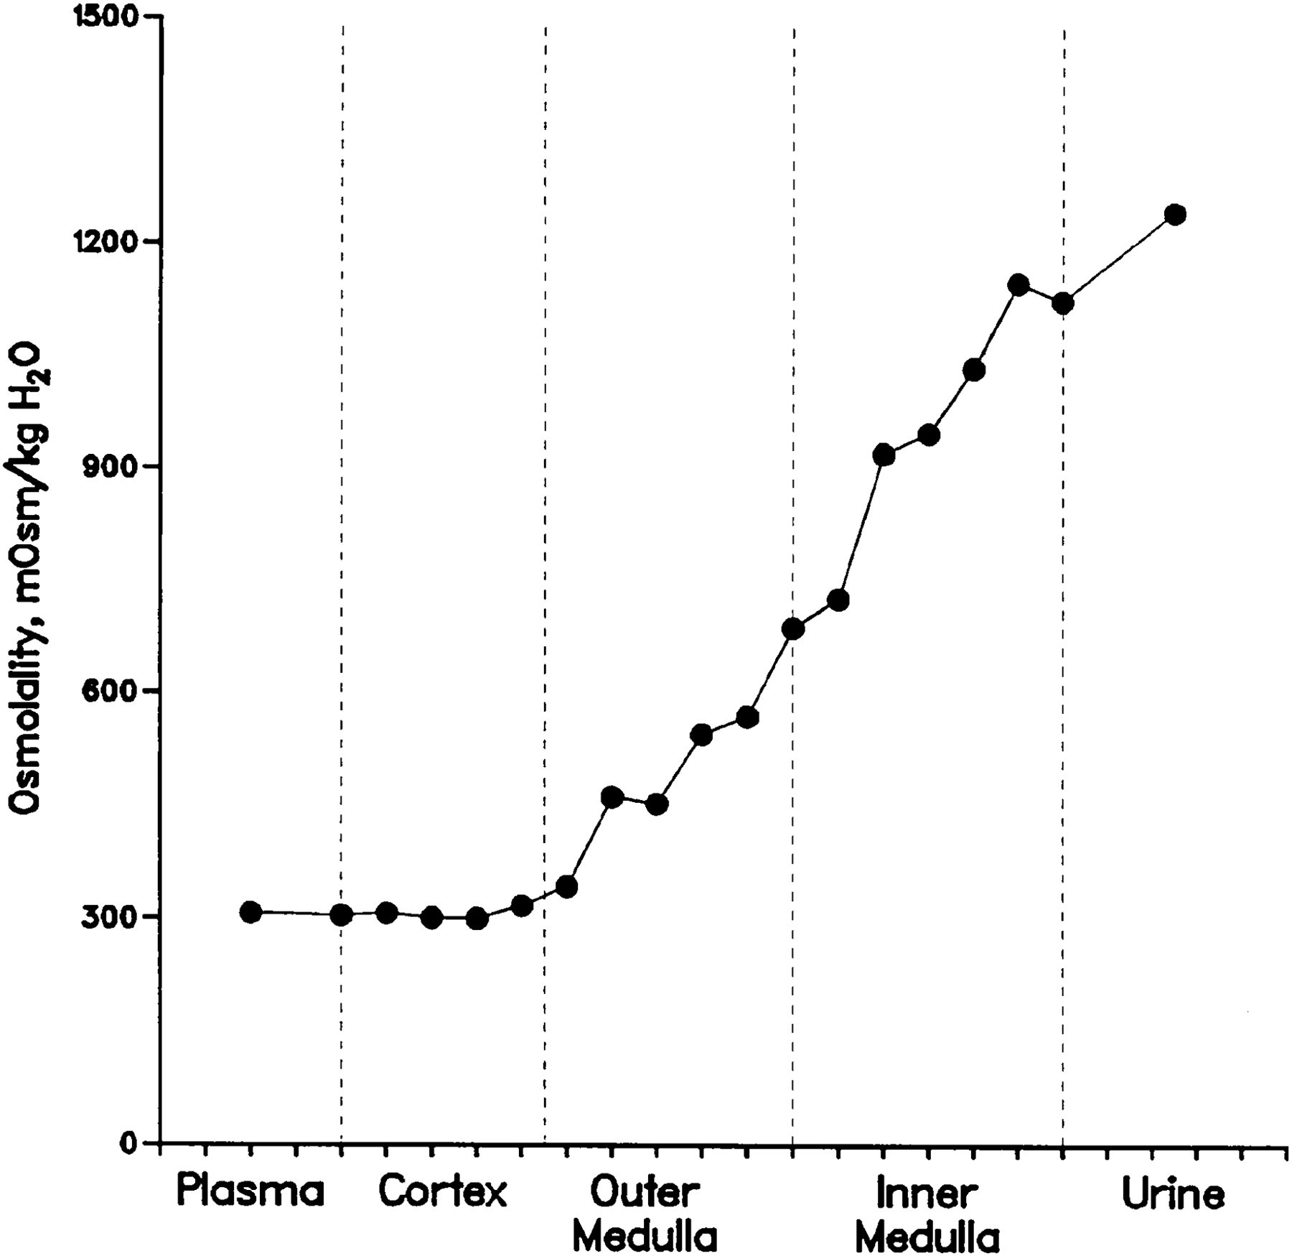
The nephron doesn't have a dedicated method to excrete sodium.
Instead, the kidneys concentrate urine by increasing urea concentration in the medulla.
Counter-intuitively, to maintain osmolality the major mechanism after an ingestion of salt is not thirst, but free water re-absorption in the kidney (ie. concentration of urine)
It takes time to generate this gradient
Kidneys retain water (with ADH) to maintain [Na] in serum in the interim
Glucocorticoid driven catabolism to generate urea
Increase urea in the renal medullary interstitium
Increase osmotic gradient to reabsorb free water
Notes:
Natriuretic peptides: increase GFR, inhibit RAAS – but no active secretion.
Rakova N, Kitada K, Lerchl K, Dahlmann A, Birukov A, Daub S, et al.
Increased salt consumption induces body water conservation and
decreases fluid intake. J Clin Invest. 2017;127(5):1932–43.
24. Kitada K, Daub S, Zhang Y, Klein JD, Nakano D, Pedchenko T, et al. High
salt intake reprioritizes osmolyte and energy metabolism for body fluid
conservation. J Clin Invest. 2017;127(5):1944–59
Yet, they
seem unable to manage an additional sodium load of a
few hundred millimoles above the usual dietary intake.
From an evolutionary viewpoint, however, this makes
perfect sense. Indeed, compared to the risks of dehydration
and sodium loss, sudden (voluntary) peaks in
sodium intake have been a virtually non-existent problem
throughout evolution.
22: Sodium retention = aldosterone mediated fluid retention

Slide 25
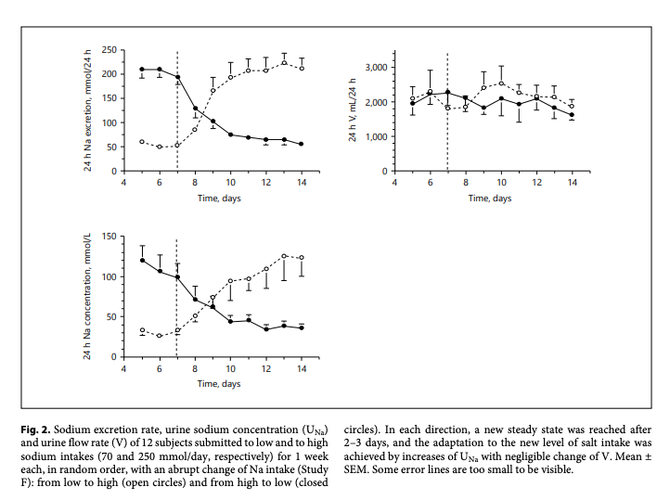
If someone who normally eats low Na diet eats high Na diet, do they drink more water?
Healthy people randomized to either low sodium (0.5 g) to regular (3.2g) diet, then swap
After increased Na load: takes ~3-5 days to reach a new steady state with kidney able to match Na load
On the first day: only half of excess Na load excreted
The positive sodium balance caused fluid retention and an increase in body weight of over 1 kg.
No difference in fluid intake (free-water reabsorption makes up difference)
Notes:
Early L. Clinical disorders of fluid and electrolyte metabolism. New York:
McGraw-Hill; 1972.

Slide 26
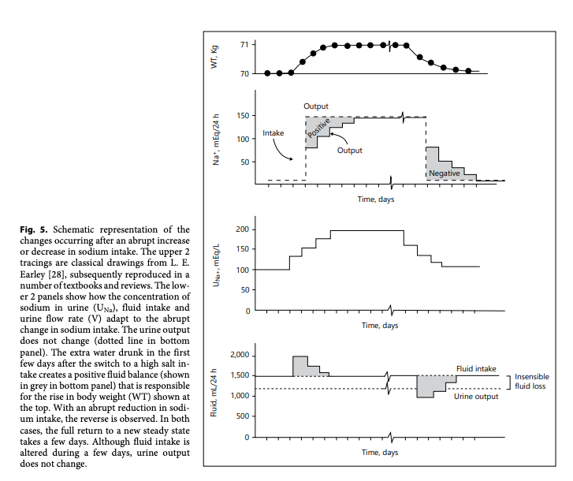
Na and fluid loading in the ICU
1L of NaCl = 3.5gm (154 mmol Na) = ~7 gm NaCl
Consider COVID-ARDS:
~750 cc/d NS from Ketamine, 350 cc/d from Fentanyl 100 cc/d ciastricurium, 200 from CTX
~4g of sodium just from sedation and NMB

Slide 27
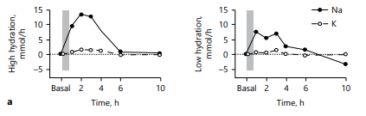
ADH is also a weak Anti-natriuretic Hormone
Healthy volunteers drank either:
Low hydration: free water 0.25 mL/kg q30m (=35 mL/hr for 70kg) or
High hydration: water 2.0 mL/kg q30m (= 288 mL/h for 70kg).
Then received 250cc 2% NaCl
High hydration: excrete the extra sodium immediately.
Low hydration cannot (ADH crosstalk, maximal concentration ability of kidneys)
Meaning: the kidneys CANNOT create low free water, high Na urine
Notes:
Does load patients with sodium then restrict sodium sound familiar?

Slide 28
Physiology Review:
The kidneys have mechanisms to quickly adjust free water clearance.
The kidney does not have a fast mechanism to increase natriuresis – it takes several days and catabolism to achieve this.
Limitation in free water hampers natriuresis due to ADH crosstalk.
While the kidney is adapting to a new baseline sodium intake, fluid retention occurs in the kidney (regardless how much fluid they drink).
Therefore, it is very hard to achieve balanced I/O during salt loading

Slide 29

Bad ARDS Circle of Life
Many Drips
(in NS)
Hypernatremia
Fluid Overload
Lasix & no
free H2O
Notes:
Irreverent
Rubbing salt in the wound

Slide 30
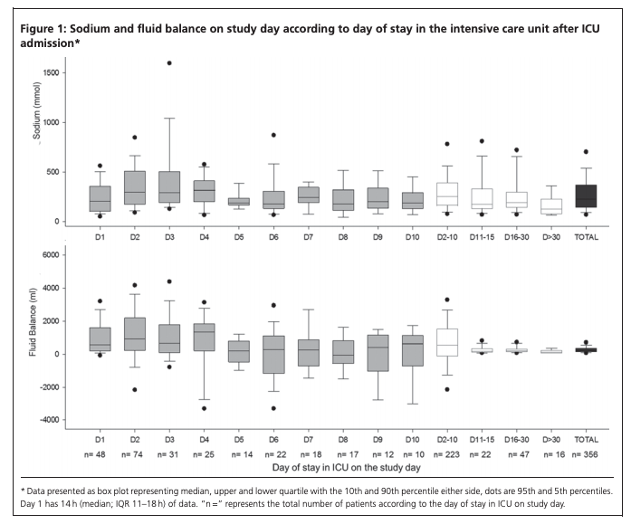
Single-day, point prevalence survey: 46 Australian and New Zealand ICUs on 21 September 2011
Median sodium admin: 224.5 mmol (IQR, 144.9-367.6 mmol). 2.8 mmol/kg (IQR, 1.6-4.7 mmol/kg).
Patients Day 2-10 of ICU admission:
maintenance or replacement intravenous (IV) infusions, 69.3mmol; 30.9% of all sodium sources;
IV fluid boluses, 36.5 mmol; 16.3%;
IV drug boluses, 27.6 mmol; 12.3%;
enteral nutrition, 26.5 mmol; 11.8%;
IV drug infusions, 19.3 mmol; 8.6%;
IV flushes, 16.6mmol; 7.4%;
blood products, 13.5 mmol; 6%;
IV antimicrobials, 11.2mmol; 5%;
parenteral nutrition, 4.3 mmol; 1.9%.
Median = 5 grams of Na per day
Double the usual intake
Notes:
George Institute for Global H, Bihari S, Peake SL, Seppelt I, Williams P,
Bersten A, et al. Sodium administration in critically ill patients in Australia
and New Zealand: a multicentre point prevalence study. Crit Care
Resusc. 2013;15(4):294–300.
A prospective
single-day point prevalence survey, conducted in 46 Australian
and New Zealand ICUs, demonstrated that maintenance
and replacement fluids are responsible for 30.9%
of the total daily sodium administration of 220 mmol
(5 g) and—contrary to common belief—a much more significant
source of sodium than resuscitation fluids

Slide 31
Why do we dissolve medications in NaCl?
ICUs have pre-mixed versions of medications to deliver quickly (ie. antibiotics, fentanyl)
Some meds are sodium salts (= any negative ion paired with a sodium cation) – generally more soluble in water than the acid form
A few medications must be given in NS
It’s the default

Slide 32
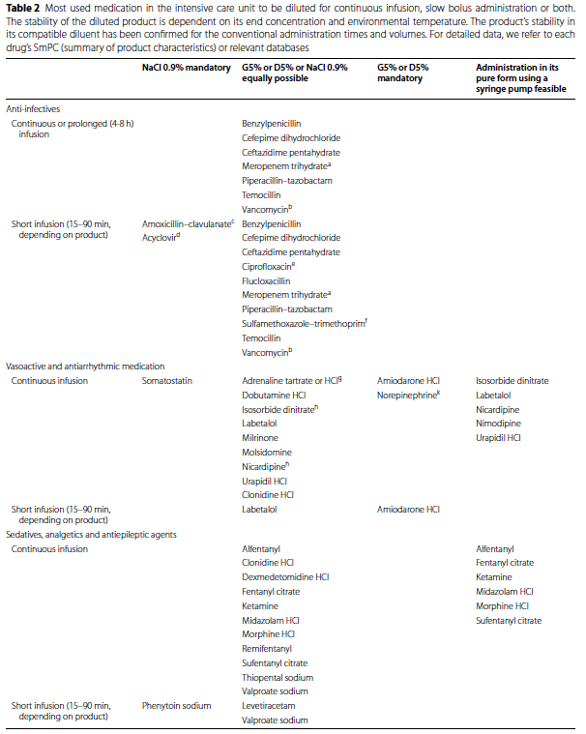
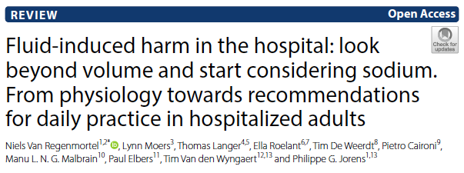
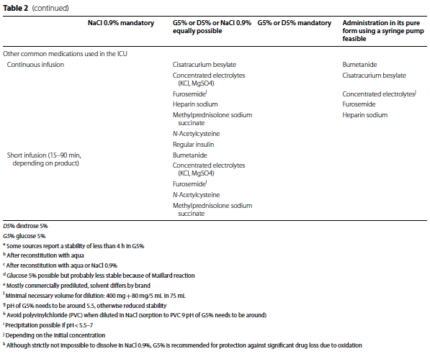

Slide 33
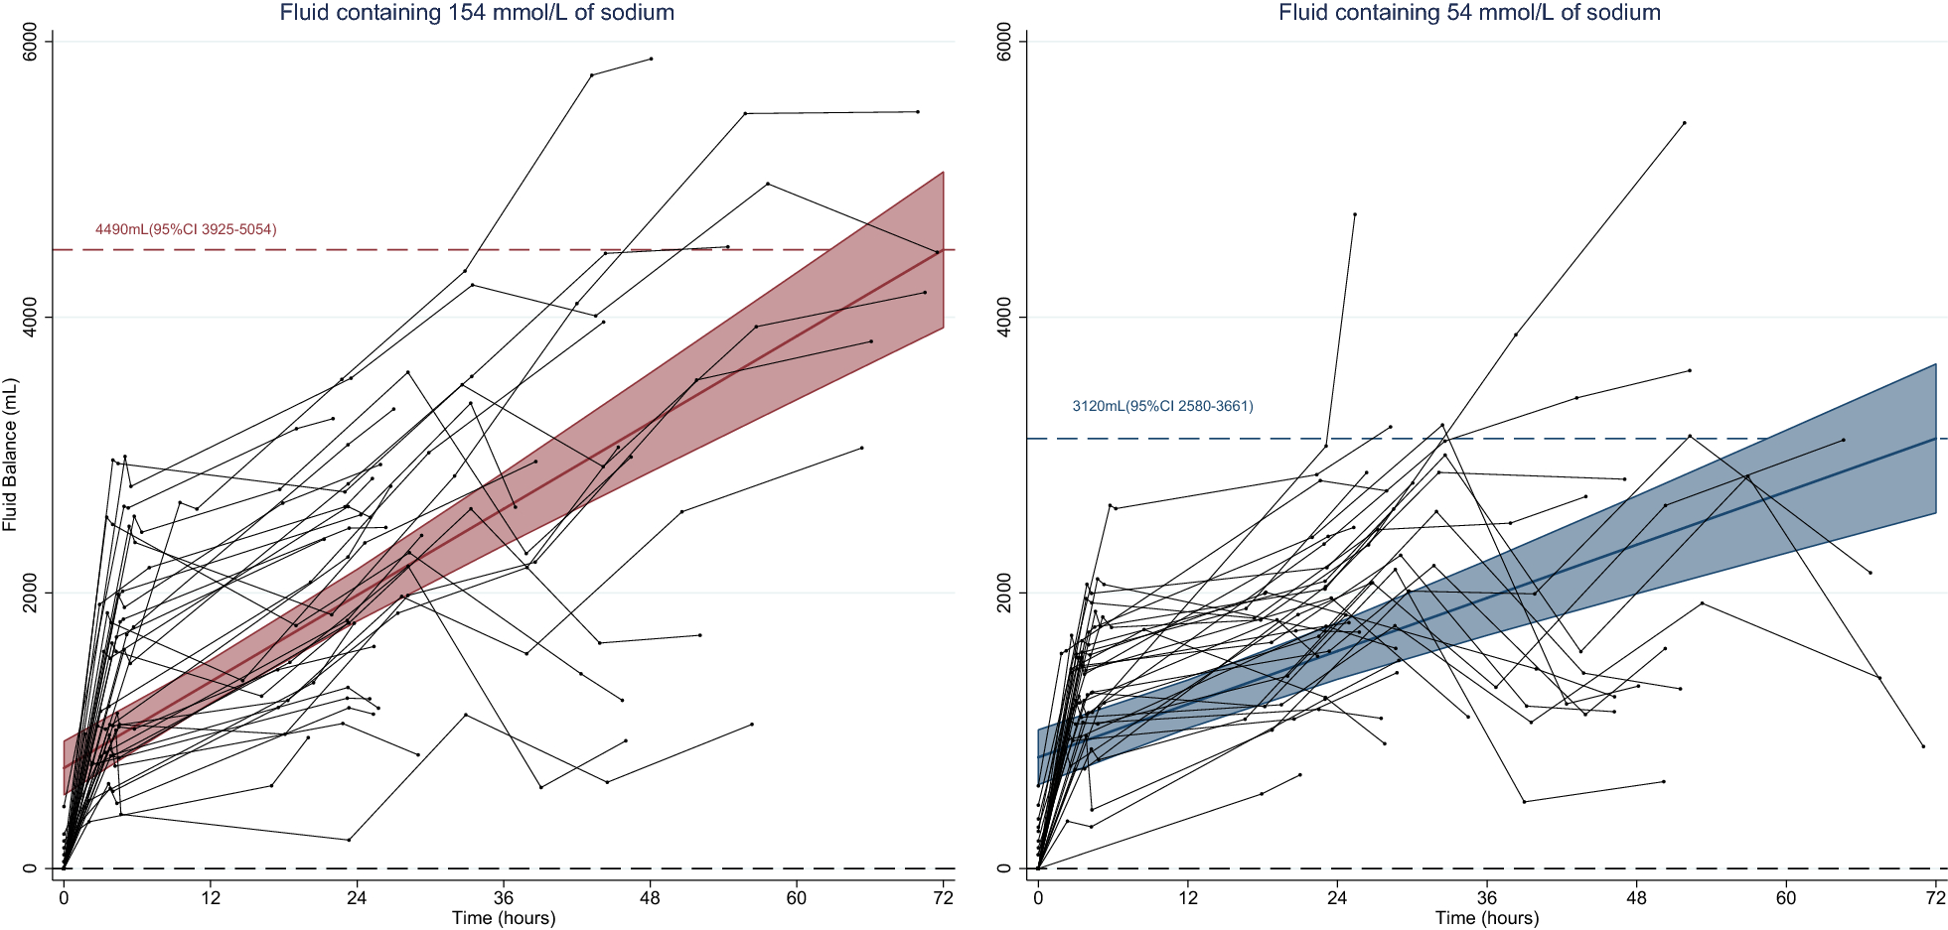
Clinical impact - TOPMAST trial
Blind randomization of 70 patients undergoing major thoracic surgery to [Na] = 154 mmol/L vs [Na] = 54 mmol/L fluid
Primary: Net fluid balance: Na154 = +4.5L vs Na54 = 3.12L despite identical fluid infused
Secondary:
Pulmonary Edema: Na154 = 17%, Na54 = 3%
Electrolyte abnormalities:
Na154 – n=3 had Na above 145.
N=24 had Cl- above ULN
Na54 – n=4 patients had Na
below 135.
Notes:
The composition of the study solution was thus responsible for an additional fluid retention of 22% (95% CI 10–34%) of its infused volume.

Slide 34
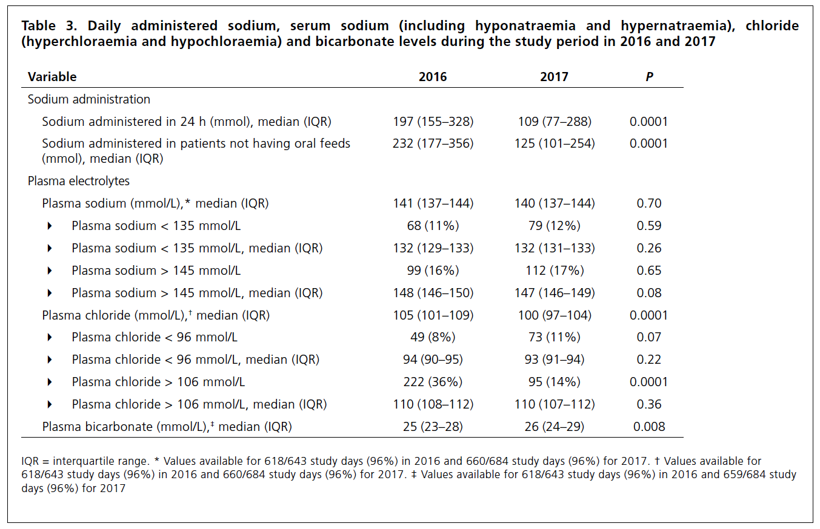
The patient is hypernatremic and congested:
Reduce Na intake (The Orme approach- is the patient on Nepro?)
Wait – their kidneys will adapt in 3-5 days
Give them more D5w – this will allow natriuresis by decreasing ADH
Maybe we should default to meds in D5w instead of NS?
If you give 2L D5w… say next day the ins = 3L, outs = 3L – have you made progress? Stay tuned…
Notes:
D5w as default medication backer
Bihari, S., Prakash, S., Potts, S., Matheson, E. and Bersten, A.D., 2018. Addressing the inadvertent sodium and chloride burden in critically ill patients: a prospective before-and-after study in a tertiary mixed intensive care unit population. Critical Care and Resuscitation, 20(4), p.285.

Slide 35
Bad ARDS Circle of Life
Use D5W instead
Many Drips
(in NS)
Driven By Na Overload
Hypernatremia
Fluid Overload
Lasix & no
free H2O
Liberal free water can allow natriuresis
Notes:
Irreverent
Rubbing salt in the wound

Slide 36
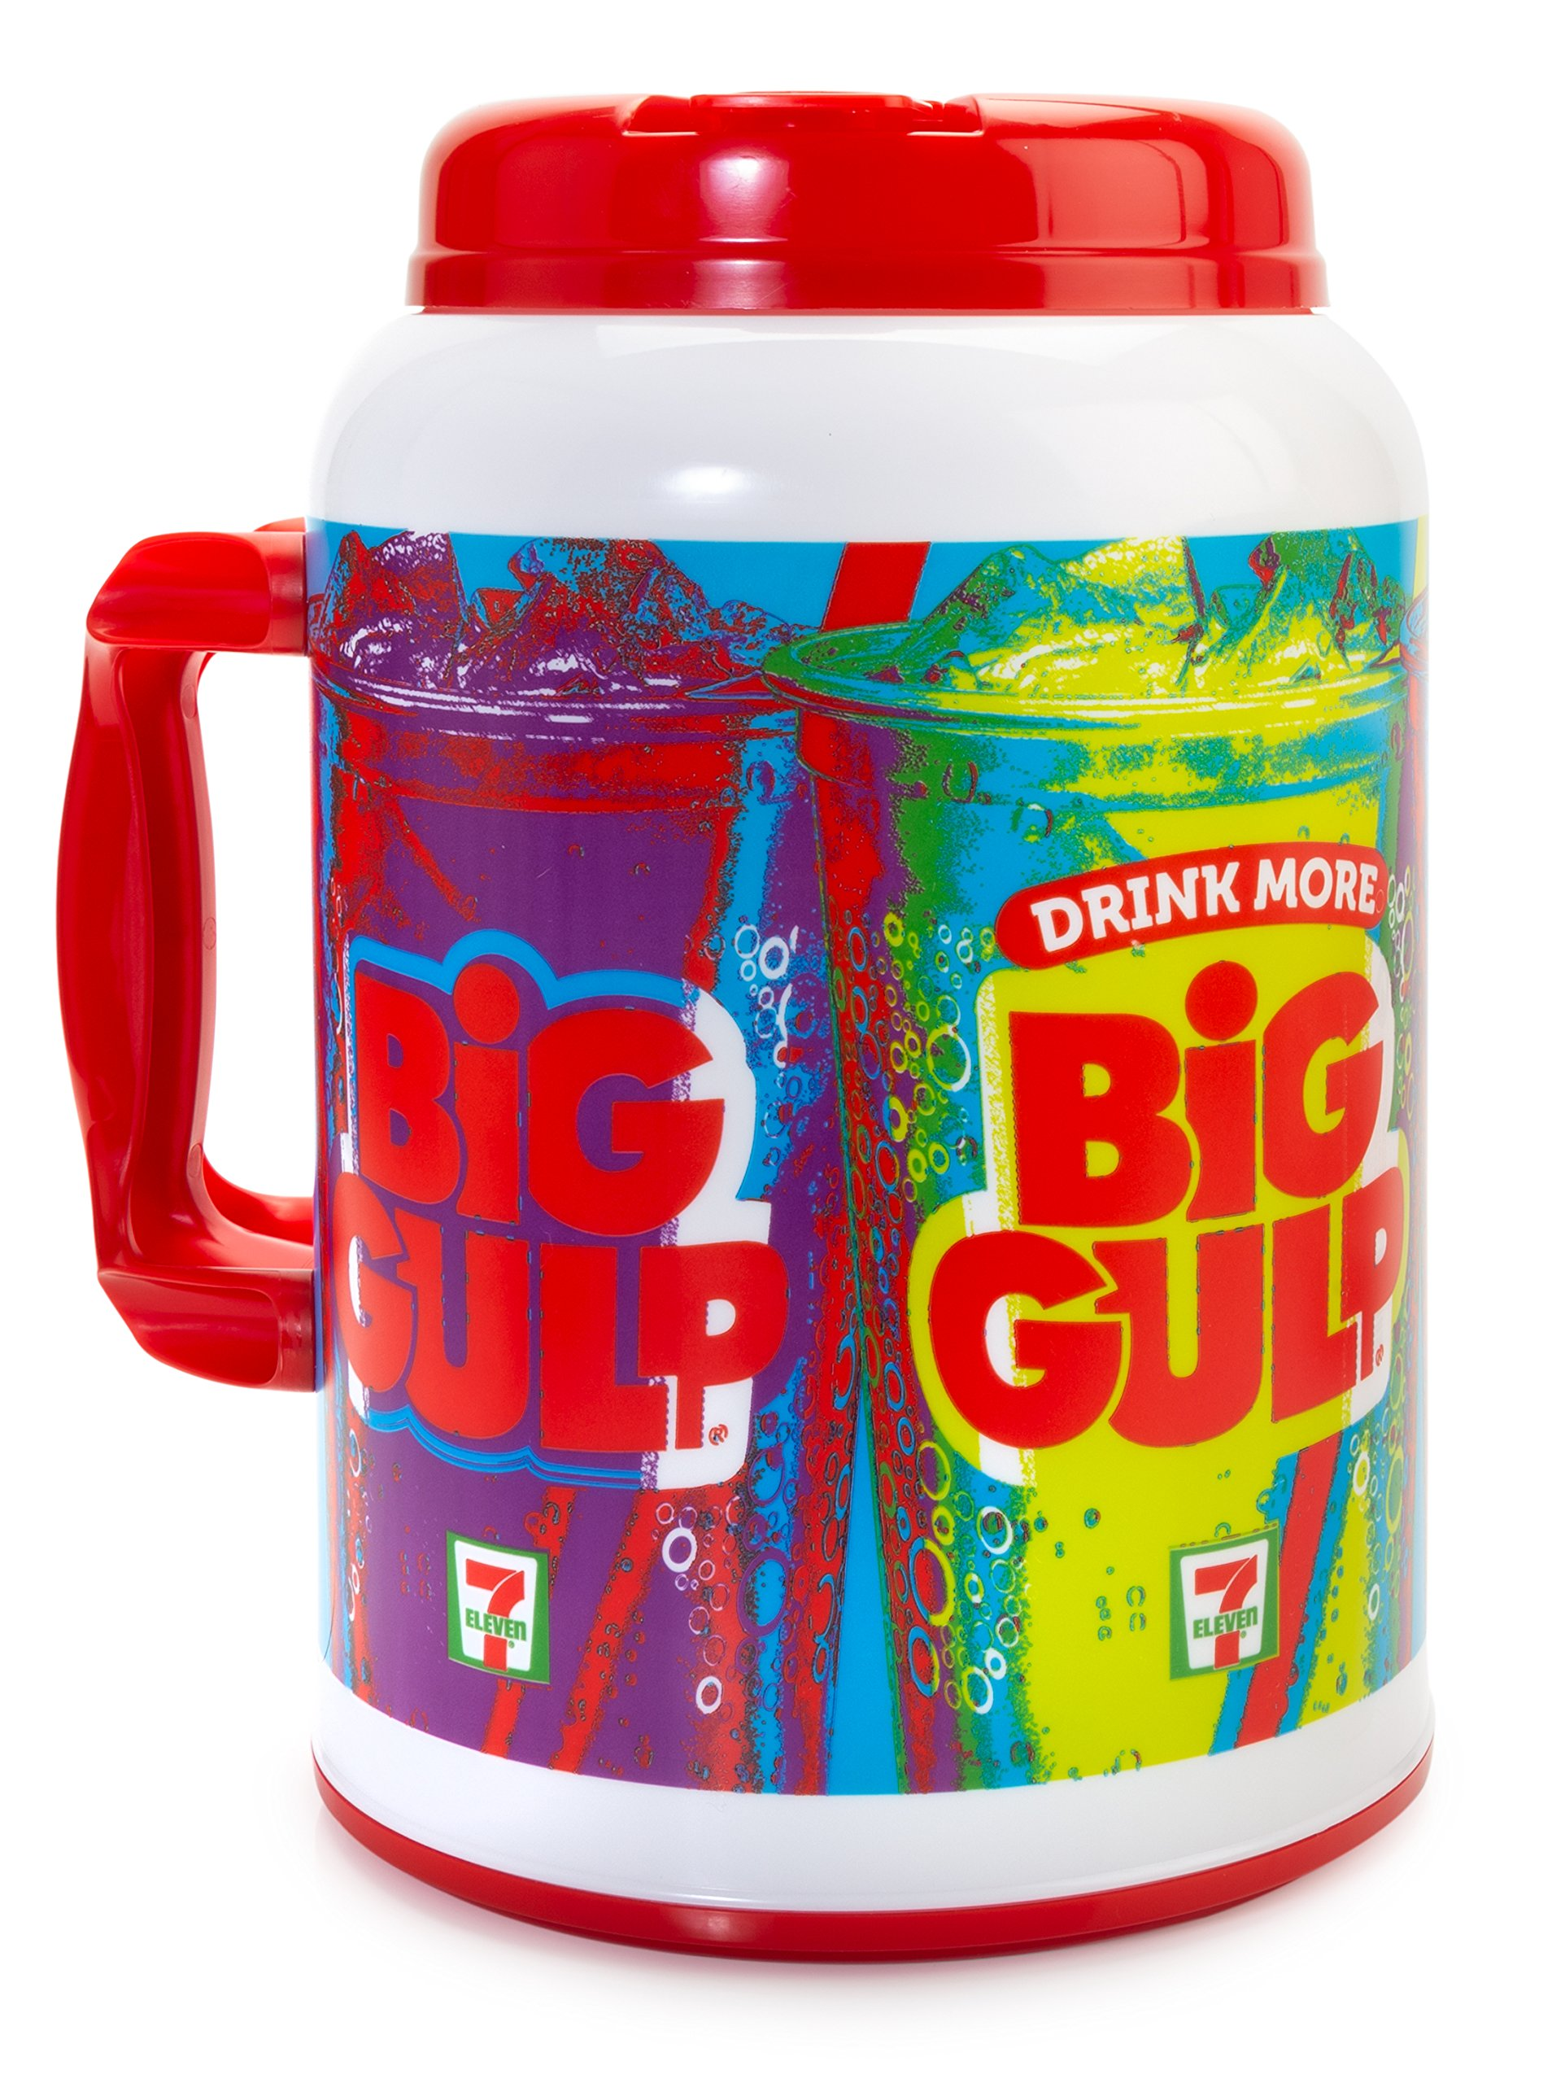
Congestion
Disorders of H2O homeostasis: Hypernatremia and Hyponatremia
Disorders of Na homeostasis: Congestion and Hypovolemia
Yet
On rounds, we present “(mLs) in and out” and not ”Na in and Na out”
Why?

Slide 37
“Despite hospitalization for HF being exceptionally common, expensive, and morbid, we have not a single Class I Level of Evidence: A guideline recommendation to guide our care of these patients”

Slide 38
A patient is congested: what initial orders are important?
Na restriction of 2g per day? Yes or No
Fluid restriction of 2L per day? Yes or No
Strict I/Os and Daily weights? Yes or No

Slide 39
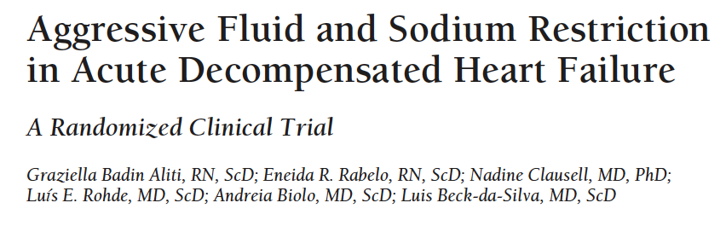
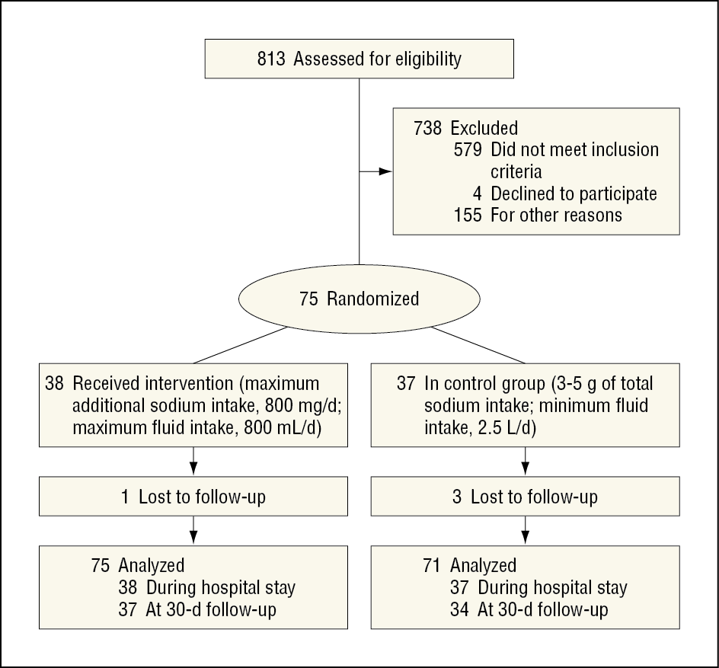
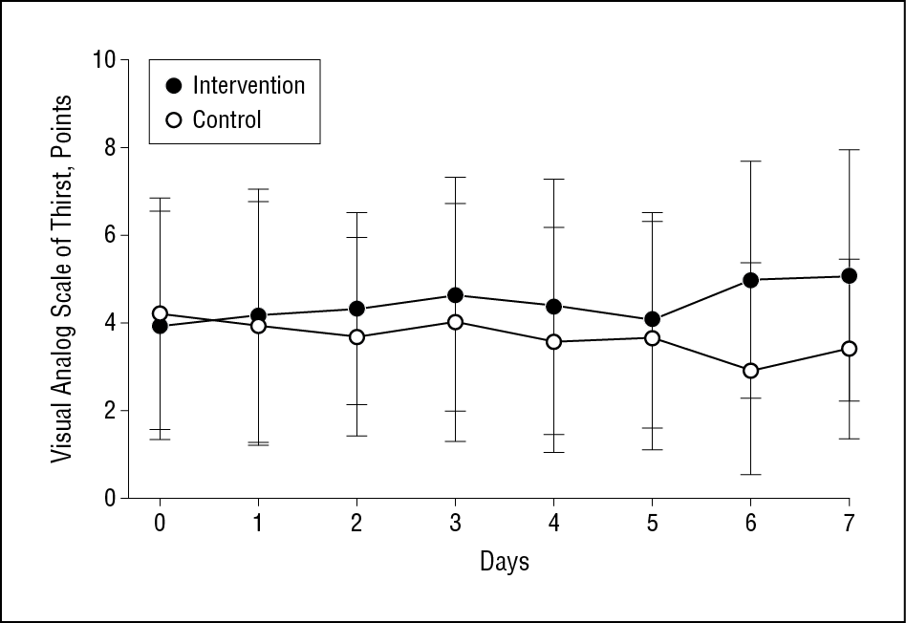
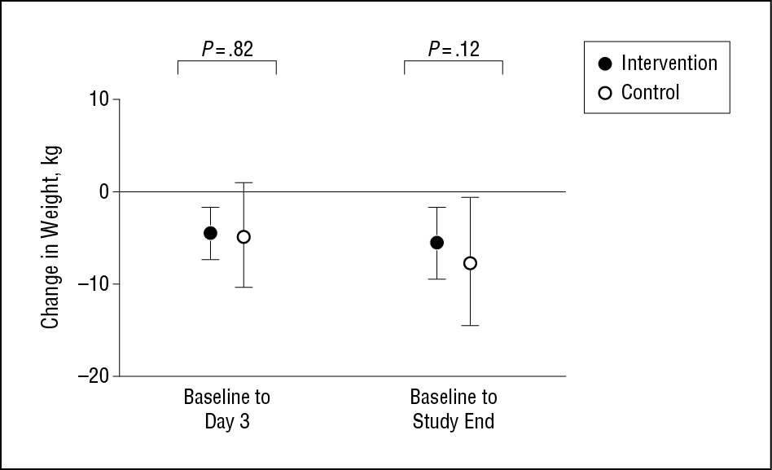
Salt and Fluid Restriction
Notes:
“The recommendations for dietary salt intake in patients with heart failure vary from “moderate sodium restriction” to less than 2 to 4 g/d, frequently with fluid restriction to less than 2 L/d.⁴ These levels are paradoxically frequently greater than the 1500 mg/d of salt recommendation of the American Heart Association and the Institute of Medicine for the general population, but less than the salt intake in the general population, and are mostly based on expert consensus rather than as a result of multiple randomized trials.”
And in fact, may be harmful in long-term: https://pubmed.ncbi.nlm.nih.gov/26738949/ . Analagous to current age where the body’s response to perturbed physiology is the actual culprit.

Slide 40
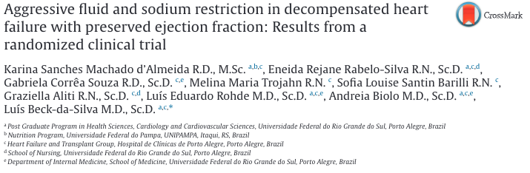
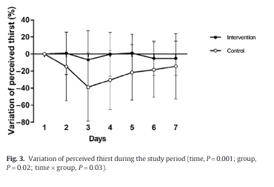
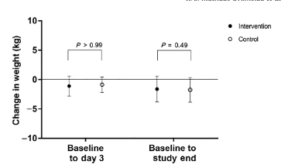
Salt and Fluid Restriction causes… thirst

Slide 41
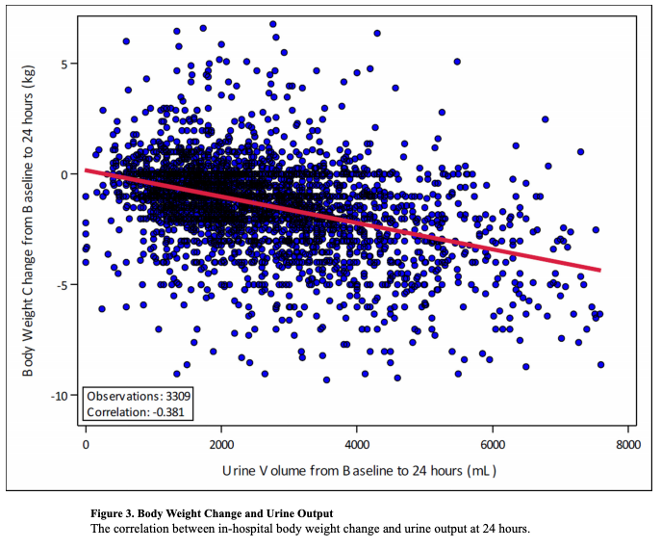
What is the problem with I/O and Kg?
Assumptions:
For I/O to be a surrogate of net natriuresis:
[Na] intake constant
D5 =/= NS
[U_Na] constant
Breaking phenomenon
Recording is accurate.
In reality, it is not
Notes:
“Fluid overload may be due to … increased fluid intake” – reverse is also not true
“typical clinician orders for “strict ins and outs,” accurate data in real-world practice can be challenged by inconsistent patient compliance and the burden of collecting these data on nursing staff”
ASCEND-HF correlation between I/O and Kg change

Slide 42
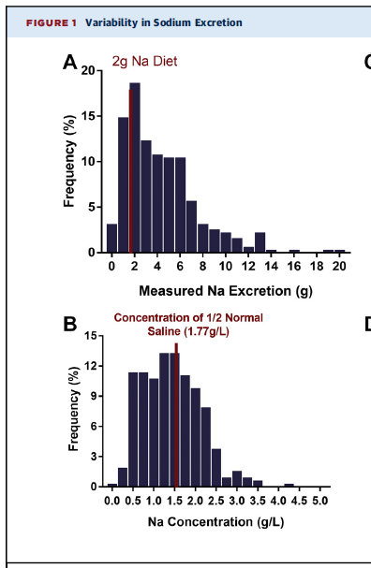
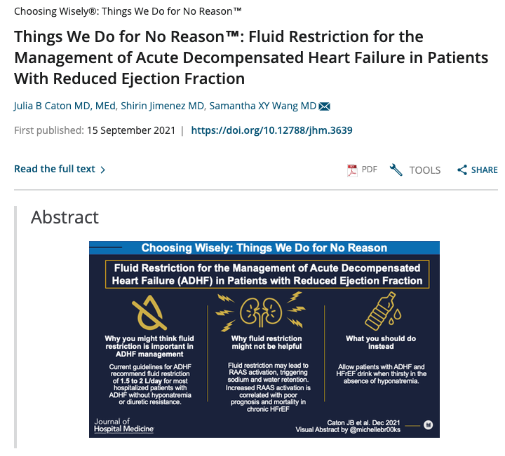
Natriuresis varies widely during diuresis
Why might the Na concentration of urine vary between patients?
Depends on ADH presence (among other other reasons).
Tight water restriction = ADH increase, natriuresis unchanged.
Loose water restriction = ADH decrease, natriuresis unchanged
Notes:
From Rao 2021

Slide 43
Urine composition by time
“the sodium content of diuretic-induced urine is highly variable and correlates only modestly with fluid and weight loss”
Notes:
https://www.ahajournals.org/doi/full/10.1161/circheartfailure.114.001377
Patients with HFrEF presenting with congestion and requiring IV diuretic. Many received spironolactone and thiazide as well.
Left = volume, middle = Na, right = ratio aka concentration.
(bottom shows that differences are attributable to de-escalating doses)
urinary composition during decongestive treatment is characterized by a progressive decrease in urinary Na⁺ and Cl⁻ excretion, even after correction for diuretic dose
Urine output was substantially higher during the first (2700 mL [1900–3450 mL]) when compared with that during the second (1550 mL [1006–2075 mL]) or third (1375 mL [1200–2200 mL]) 24-hour intervals -> primarily due to decrease in dosing.
=> Impact = Natriuresis resistance is probably even higher than diuretic resistance, and we wouldn’t necessarily know based on I/O tracking.

Slide 44
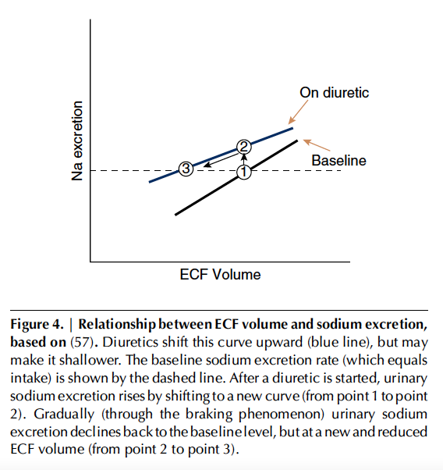
Braking Phenomenon (of natriuresis)
Assume a patient makes no dietary changes
Sodium clearance increases with ECF (true)
Off diuretics, a patient takes in 3g of Na in 24h. They are at steady state. 3g of Na must be excreted in 24h. They are congested.
If you start a diuretic, initially their ECF is unchanged (congested), but natriuresis increases.
They eventually reach a new steady state (in=out), but at a lower ECF
Notes:
Ellison, D. H. (2019). Clinical pharmacology in diuretic use. Clinical Journal of the American Society of Nephrology, 14(8), 1248-1257
“Diuretics are recommended universally to treat symptomatic ECF volume expansion, with rare exceptions, and therapeutic success is considered to be reduction in ECF. This invariably requires initial sodium and water losses, induced by diuretic doses that exceed the threshold (Figure 4). Yet the situation
changes as initial treatment moves toward successful chronic treatment. At any therapeutically active dose, natriuresis wanes as ECF declines, an effect often called the “braking phenomenon” (58). This means that, at steady state, the individual returns to NaCl balance, during which urinary NaCl excretion
is equal to dietary NaCl intake once again. This occurs, however, at a lower ECF volume than before treatment.”
2gm of 24h intake = 2 gm 24h output once at equilibrium
If you start diuretics -> NaCl excretion will eventually equilibrate with NaCl intake, but at a lower ECF volume. This decrease is caused the breaking phenomenon. This starts to occur immediately, and explains why the U_Na concentration decreases as you go on. This is mediated by the sympathetic nervous system (e.g. RAAS), and is maladaptive if it occurs before euvolemia has been restored.

Slide 45
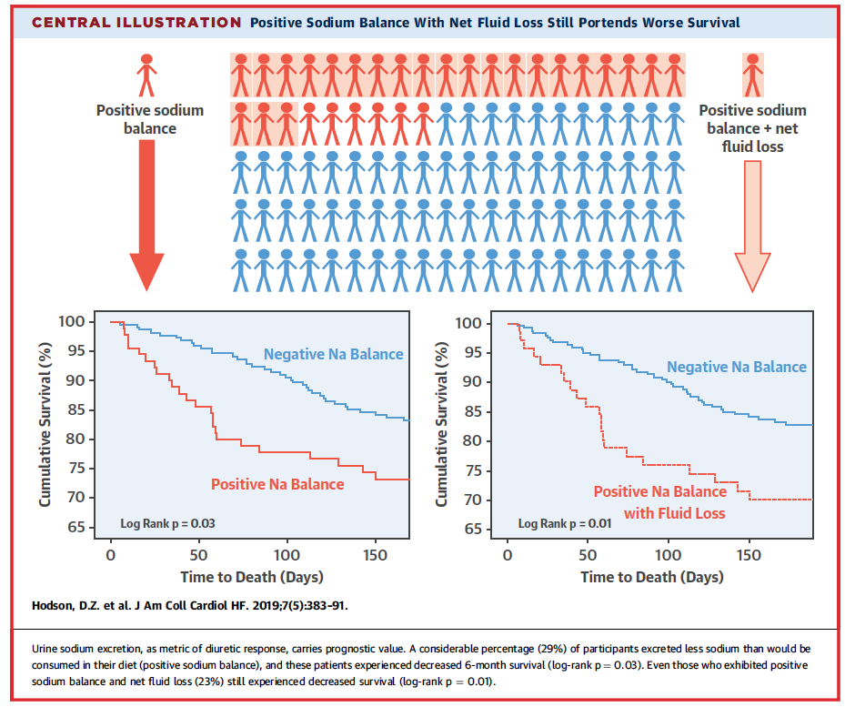
Discordant Diuresis and Natriuresis
 | Net Na drops a little | Net Na drops a lot
Net I/O drops a little | Not much response, normal [U_Na] | Good natriuresis, high [U_Na]
Net I/O drops a lot | Good diuresis, Low [U_Na] | Good response, normal [U_na]
Notes:
Hodson, D. Z., Griffin, M., Mahoney, D., Raghavendra, P., Ahmad, T., Turner, J., ... & Testani, J. M. (2019). Natriuretic response is highly variable and associated with 6-month survival: insights from the ROSE-AHF trial. JACC: Heart Failure, 7(5), 383-391.
However, total urine output (adjusted HR/l: 0.93; 95% CI: 0.77 to 1.11; p . 0.43), net fluid balance (adjusted HR/l: 0.98 (95% CI: 0.83 to 1.17; p . 0.87), and weight loss (adjusted HR/kg: 0.94; 95% CI: 0.85 to 1.04; p . 0.25) were not significantly associated with survival.
So what if you loosen up water restriction, I/O = negative but net natriuresis is achieved?

Slide 46
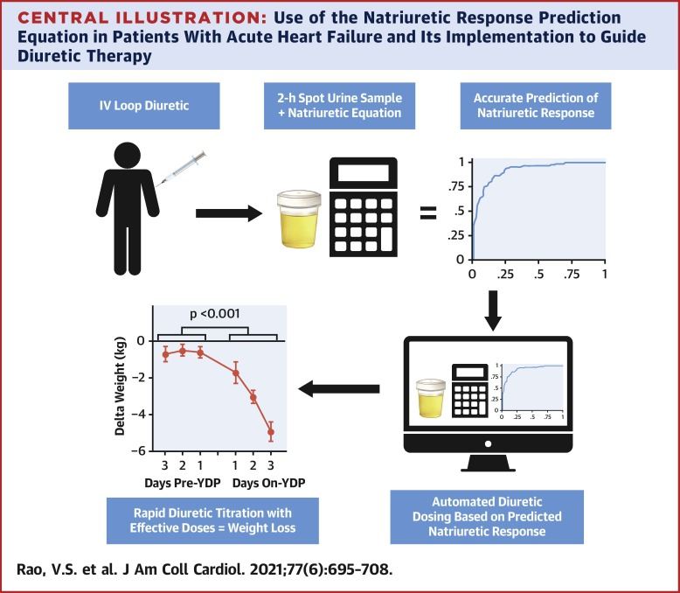
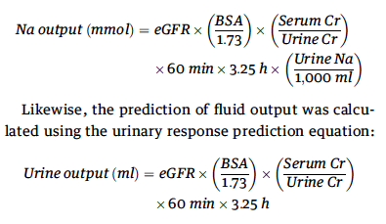
Natriuresis based decongestion
Simple: Spot urine Na > 100 2h after dose = was probably effective (will lead to net 2g+ natriuresis in BID dosing)
Complex:
Notes:
https://pubmed.ncbi.nlm.nih.gov/33573739/

Slide 47
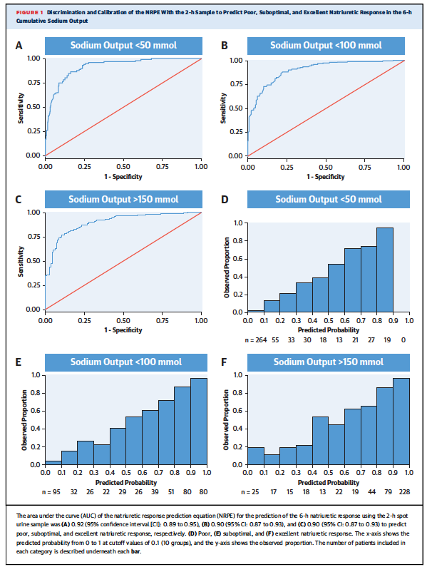
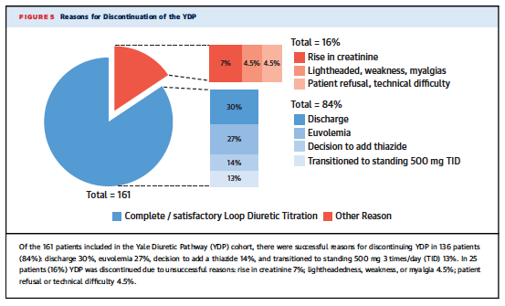
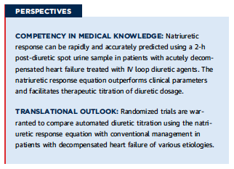
Does it work?
NCT04481919 RCT with hard outcome end-points ongoing
Notes:
Within the 6-h cumulative collection, spot urine samples were obtained at hours 1, 2, and 6. Compared with the reference value of the directly measured 6-h cumulative sodium output, the NRPE using spot urine sodium and creatinine values 2 h following diuretic administration showed exceptional discrimination for poor, suboptimal, and excellent natriuretic responses, with areas under the curve ranging from 0.90 to 0.92.
Similarly, the NRPE was strongly predictive of cumulative sodium output, outperforming a series of other measures including net fluid output, spot urine sodium, and the fractional excretion of sodium.
https://twitter.com/ebtapper/status/1363237759192870913 Steps: 1. Predict diuresis using urine sodium 2. Protocolize diuretic dosing 3. Help patients with CHF feel better fast led by Dr. Veena Rao”
We applaud the investigators for pursuing a blinded randomized trial (NCT04481919).

Slide 48
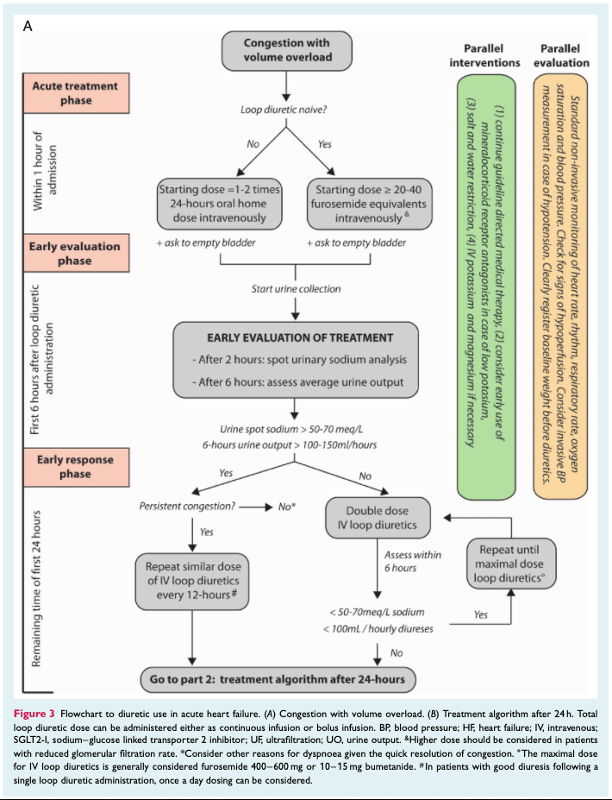
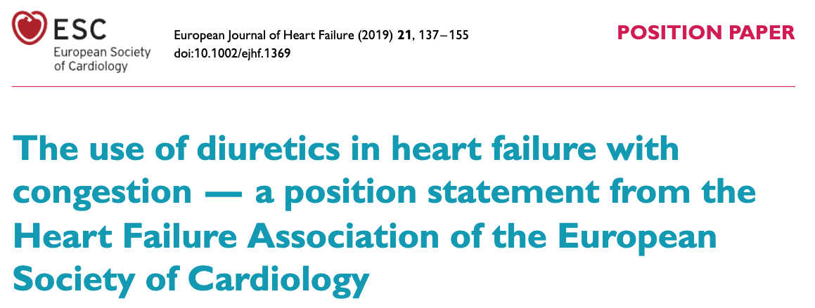

Slide 49
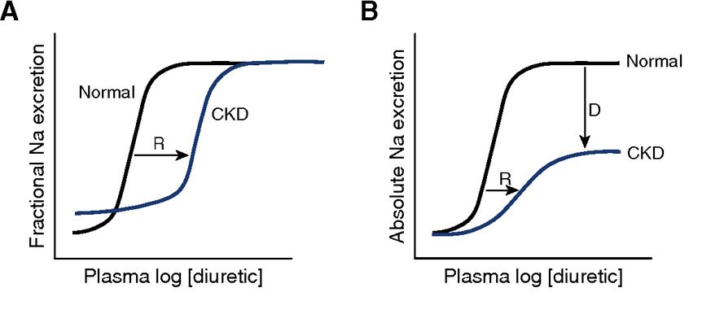
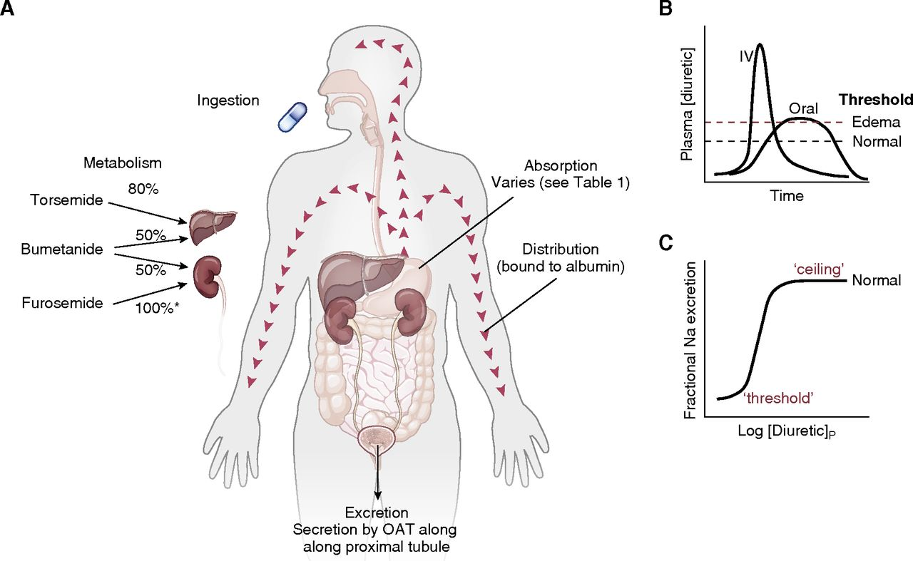
How to dose:
1. DOSE trial: 2.5x home dose and IV
2. Assess:
UOP should be 150 hr+ within 2h of IV dose (don’t wait 6 to see)
U_Na should be 50-70+
Why are you not giving a higher dose?
 | Would respond to low dose | Needs high dose
Give low dose | ☺ | Delayed in needed care
Give high dose | What’s the harm? | ☺
Notes:
https://cjasn.asnjournals.org/content/14/8/1248#sec-4 CJASN 14: 1248–1257, 2019. doi: https://doi.org/10.2215/CJN.09630818.
Furosemide is secreated in tubule lumen (not filtered due to being protein bound).
This process is inhibited by NSAIDs

Slide 50
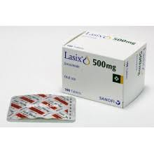
Toxicity without volume depletion?
1985: Patient with oliguric AKI were given “1 g furosemide was given as a single injection over four hours. In the test group, frusemide was then continued either intravenously or orally in a dose of 3 g/24 hr until a urine output of 200 ml/hr was sustained or until the plasma creatinine fell …The serious complication of deafness occurred in two of 28 patients and in one of them this was permanent.”
2021: Yale Diuretic Protocol: “automated, nurse-driven, and called for administration of 2 to 12.5 mg IV bumetanide up to 3 times daily.” “rapidly escalated toward a peak of 1,500 mg IV furosemide equivalents per day that was reached in the first 2 days of the protocol in 86% of patients.” “No cases of ototoxicity (n=409)
Meta-analysis: OR 3 of developing ototoxicity when dose excess 1 GRAM daily (~40 mg/hr)
NOT A NEPHROTOXIN
Notes:
https://journals.sagepub.com/doi/10.1177/00369330740190S108
“In the Yale Diuretic Protoco (JACC 2021)l: used primarily in folks with diuretic resistance. The protocol was automated, nurse-driven, and called for administration of 2 to 12.5 mg IV bumetanide up to 3 times daily. With initiation of the YDP, diuretic dosing was rapidly escalated toward a peak of 1,500 mg IV furosemide equivalents per day that was reached in the first 2 days of the protocol in 86% of patients. In 84% of cases, the YDP was terminated for satisfactory reasons (i.e., discharge, euvolemia, addition of thiazide diuretic, and transition to standing dose 12.5 mg bumetanide 3 times daily). The remaining 16% of patients had the YDP terminated for unfavorable reasons (e.g., worsening renal function); yet, the risk of electrolyte abnormalities, hypotension, and worsening renal function were similar pre- and post-initiation of YDP.”

Slide 51
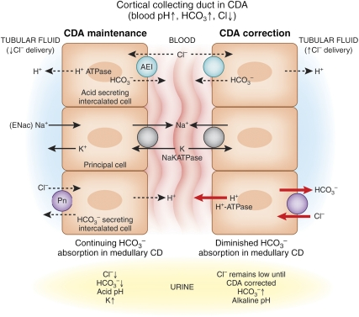
“Suspect near euvolemia due to contraction alkalosis”
Loop diuretics create Chloride (and Sodium)-Rich urine
Loosing Cl- rich, ‘bicarbonate poor’ urine will lead to development of alkalosis at ANY extracellular volume.
Pendrin: Chloride – Bicarbonate exchanger to maintain neutrality
Not “contraction” (albumin will not fix it), but “chloride depletion” (saline will).
Notes:
Luke, R. G., & Galla, J. H. (2012). It is chloride depletion alkalosis, not contraction alkalosis. Journal of the American Society of Nephrology, 23(2), 204-207.

Slide 52
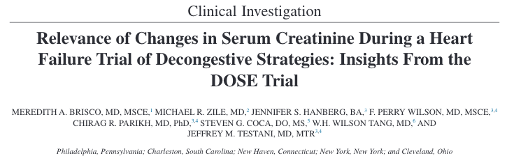
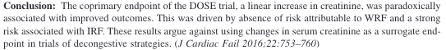
Diurese until sCr clearly increases: No intrinsic renal injury from diuretic caused creatinine increase
Notes:
In fact, post hoc analyses of large trials suggest that those who experience a moderate increase in creatinine (worsening kidney function) may actually have better prognosis than those who do not (55,56).
Survival plots of the risk of death, rehospitalization, or emergency department visit by stable, worsening, or improvement in renal
function. WRF and IRF were defined by >0.3 mg/dL change in serum creatinine (A) and a ≥20% change in eGFR (B). Patients who did
not meet criteria for WRF or IRF were classified as having Stable
RF. IRF, improvement in renal function; RF, renal function; WRF:
worsening renal function.
Brisco MA, Zile MR, Hanberg JS,Wilson FP, Parikh CR, Coca SG,
Tang WH, Testani JM: Relevance of changes in serum creatinine
during a heart failure trial of decongestive strategies: Insights from
the DOSE trial. J Card Fail 22: 753–760, 2016
Another study showing the same
Ahmad T, Jackson K, Rao VS, TangWHW, Brisco-BacikMA, Chen
HH, Felker GM, Hernandez AF, O’Connor CM, Sabbisetti VS,
Bonventre JV, Wilson FP, Coca SG, Testani JM: Worsening renal
functioninpatients with acute heart failure undergoing aggressive
diuresis is not associated with tubular injury. Circulation 137:
2016–2028, 2018

Slide 53
Congestion: Review
Realize that I/O’s are a surrogate for what we care about (Na flux)
Salt and Fluid restrictions are TWDFNR in patients with normal [Na+]
Give higher doses of loop diuretics
Do not use elevated [HCO3-] as a reason to stop diuresing

Slide 54
Key References
Hyponatremia:
https://www.coreimpodcast.com/2021/02/10/5-pearls-on-hyponatremia-episode-1/
Desmopressin to Prevent Rapid Sodium Correction in Severe Hyponatremia: A Systematic Review: DOI: 10.1016/j.amjmed.2015.04.040
Hypernatremia:
Fluid-induced harm in the hospital: look beyond volume and start considering sodium. From physiology towards recommendations for daily practice in hospitalized adults: https://doi.org/10.1186/s13613-021-00851-3
Congestion:
The use of diuretics in heart failure with congestion - a position statement from the Heart Failure Association of the European Society of Cardiology: https://onlinelibrary.wiley.com/doi/10.1002/ejhf.1369
It Is Chloride Depletion Alkalosis, Not Contraction Alkalosis: https://doi.org/10.1681/ASN.2011070720

